Slide 1
ABSTRACT
Purpose. To expand the behavioral Ocular Motor System (OMS) model for Infantile Nystagmus Syndrome (INS) by incorporating the variation of IN amplitude with gaze angle.
Methods. In a previous study, gaze-angle effects in Fusion Maldevelopment Nystagmus Syndrome (i.e., foveating and defoveating fast-phase alternation) waveforms were simulated, guided by Alexander’s law input. Alexander’s law describes the increase in the amplitude of nystagmus as the eye is moved in the direction of the fast phase. In the current study, fixation data from INS subjects at various gaze angles were examined and used as templates for the simulations. All simulations were performed in the MATLAB Simulink environment. The original OMS model is available online at http://www.omlab.org.
Results. The Alexander’s law functional block in the internal monitor of the OMS model is based on a tonic imbalance signal and efference copy of eye position signal. In INS, the “null” position and sharpness could be approximated by the two Alexander’s law relationships (one for each direction), with their intersection indicating the “null” position and the slopes of the curves controlling the broadness of the “null.” At various gaze angles, these Alexander’s law relationships influenced the slow-phase amplitude of IN waveforms differently, thus mimicking the same gaze-angle effects as we observed in INS patients.
Conclusions. The behavioral output of the OMS model demonstrated the effectiveness of using Alexander’s law input to simulate the variation of IN waveforms across the whole visual domain. This improvement in the OMS model adds another step in the implementation of a complete and idiosyncratic OMS model that can simulate normal as well as pathological (i.e., INS) behaviors.
Nothing to Disclose.

Slide 2
OMS MODEL: INS
Foundations/Requirements (based on recorded data):
Simulate normal saccadic and pursuit responses
Contain ALL necessary functional OMS blocks
IN waveforms are independent of prior saccades
ALL saccades within waveforms are corrective
IN waveforms must contain foveation periods ON TARGET
NO OSCILLOPSIA (i.e., the model has stable signals representing reconstructed target position and velocity)
Models of INS Models of Foveation Periods

Slide 3
OMS MODEL
Emergent Behavior:
  Voluntary saccade amplitudes were modulated by the IN
  Normal saccadic system shifted IN waveforms to allow target foveation
  Occasional missed braking saccades resulted in larger IN; i.e., braking saccades damped the IN
  Spontaneous bias reversals were automatically caused by small voluntary saccades correcting accumulated position error
  IN slow phases could suppress required corrective saccades following hypometric saccades and accomplish target acquisition
  Foveating saccade-magnitude variability reflected minor motor-command variability
  Braking and foveating saccade magnitudes were affected by slow-phase velocity
  Initial catch-up saccades during ramp and step-ramp pursuit were diminished by IN slow phases
Emergent Behavior Support for Hypothetical Mechanisms

Slide 4
QUESTIONS
What causes the variation of INS with gaze angle?
Is it related to the Alexander’s law variation of vestibular and fusion maldevelopment nystagmus?
Can the position and sharpness of NAFX peaks (INS “nulls”) be determined by the intersection and slopes of the Alexander’s law line for each direction ?

Slide 5
HYPOTHESES
Improper calibration of the Alexander’s law control of vestibular nystagmus affects the amplitude of INS as gaze angle is changed.
The intersection and slopes of the linear Alexander’s law relationships for nystagmus in each direction determine the position and sharpness of NAFX peaks.

Slide 6
METHODS
Ocular motor simulations using a behavioral OMS model were performed in MATLAB Simulink.
Simulations of different types of INS variation with gaze angle were based on eye-movement data that were calibrated using the foveation periods of the fixating eye.

Slide 7
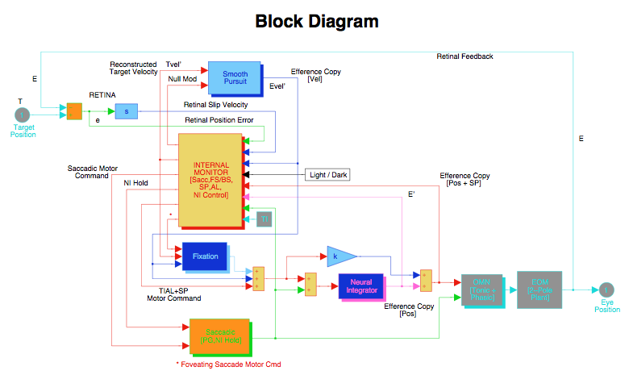
INS Block Diagram

Slide 8
INS Model

Slide 9
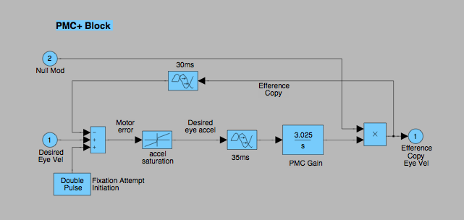
AL Gain Modulation in PMC+ Block
Notes:
Block Diag of PMC+ Block w AL input

Slide 10
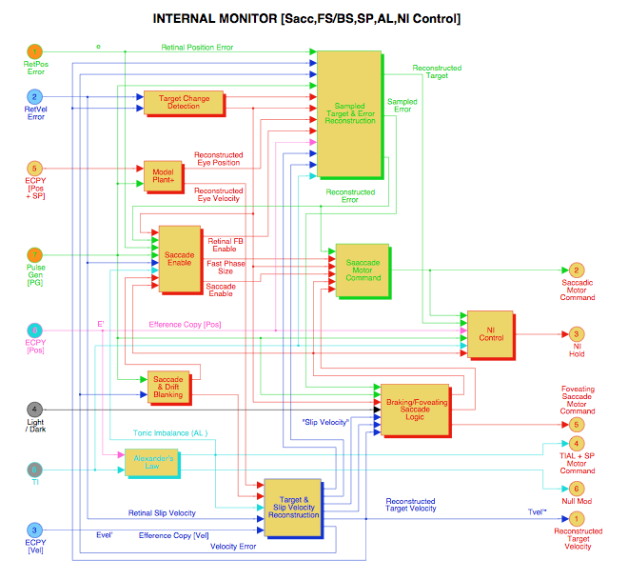
Internal Monitor

Slide 11
METHODS
Alexander’s law output used in the PMC+ block to alter the gain of the INS oscillation.
Alexander’s law slopes and intersections set to simulate different INS vs. gaze angle characteristics.
Model run with positive and negative step-changes in target position during both Pfs and PPfs INS waveforms.
Model outputs plotted on same graph to observe saccadic responses and INS changes with gaze angle.
Notes:
AL slopes and intersections set to simulate different INS vs GA characteristics

Slide 12
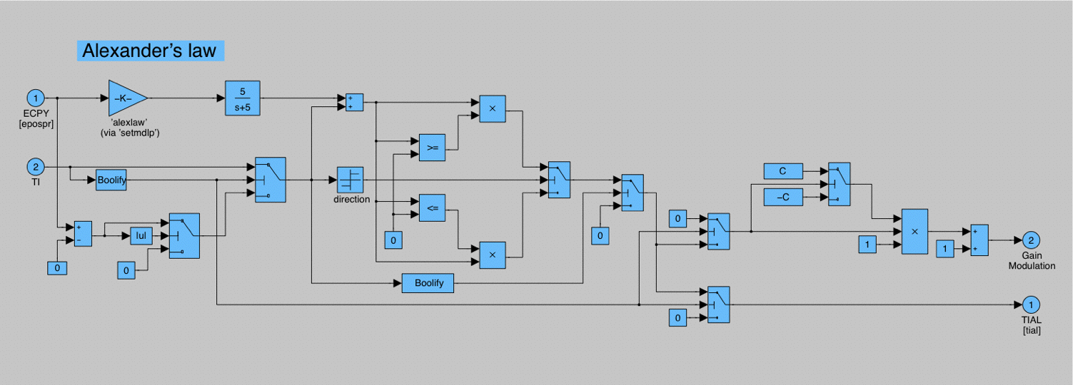
Alexander’s Law Block
Notes:
Block Diag of AL

Slide 13
MODEL PREDICTIONS
Notes:
At 0 and + null angle, Broad NAFX peak
At 0 and - null angle, Moderate NAFX peak
At 0 and + null angle, Sharp NAFX peak

Slide 14
MODEL PREDICTIONS
Notes:
At 0 and + null angle, Broad NAFX peak
At 0 and - null angle, Moderate NAFX peak
At 0 and + null angle, Sharp NAFX peak

Slide 15
MODEL PREDICTIONS
Notes:
At 0 and + null angle, Shallow AL slopes --> Broad “null”
At 0 and - null angle, Moderate AL slopes --> Moderate “null”
At 0 and + null angle, Sharp AL slopes --> Sharp “null”

Slide 16
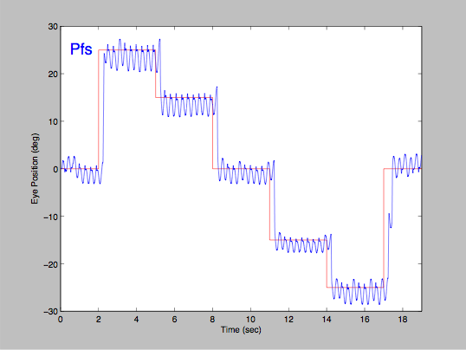
MODEL OUTPUTS
(Pfs, Sharp “Null”)
“Null”
Notes:
At 0 and + null angle, Sharp AL slopes --> Sharp “null”

Slide 17
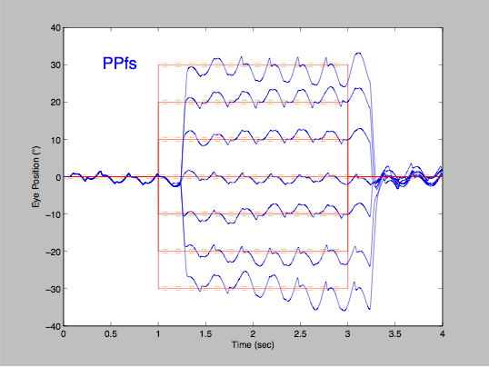
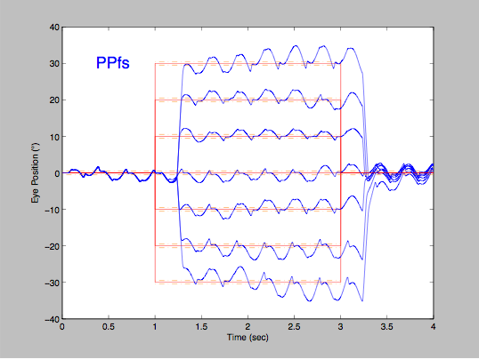
MODEL OUTPUTS
(Sharp “Nulls”)
“Null”
“Null”
Notes:
At 0 and + null angle, Sharp AL slopes --> Sharp “null”

Slide 18
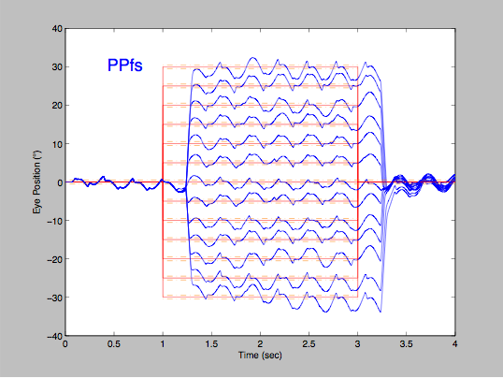
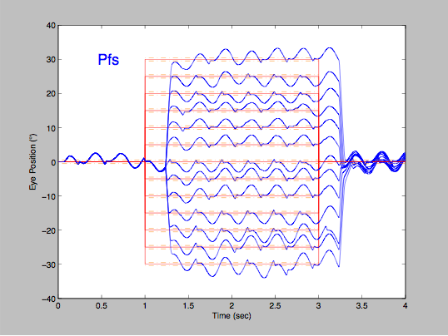
MODEL OUTPUTS
(Medium “Nulls”)
“Null”
“Null”
Notes:
At 0 and - null angle, Moderate AL slopes --> Moderate “null”

Slide 19
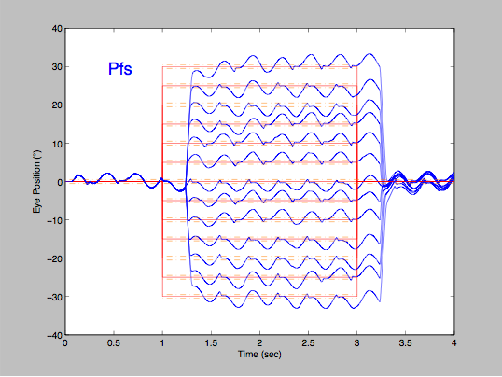
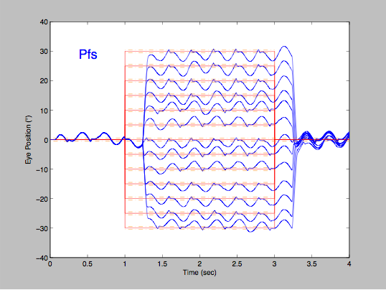
MODEL OUTPUTS
(Broad “Nulls”)
“Null”
“Null”
Notes:
At 0 and - null angle, Shallow AL slopes --> Broad “null”

Slide 20
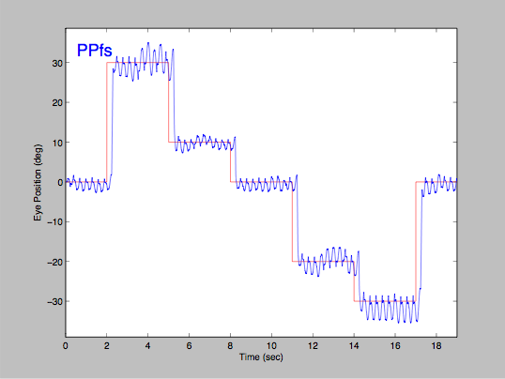
MODEL OUTPUTS
(PPfs, Sharp “Null”)
“Null”
Notes:
At 0 and + null angle, Sharp AL slopes --> Sharp “null”

Slide 21
INS CHARACTERISTICS
(NAFX vs Gaze Angle)
Notes:
At 0 and + null angle, Shallow AL slopes --> Broad “null”
At 0 and - null angle, Moderate AL slopes --> Moderate “null”
At 0 and + null angle, Sharp AL slopes --> Sharp “null”

Slide 22
INS CHARACTERISTICS
(NAFX vs Gaze Angle)
Notes:
At 0 and + null angle, Shallow AL slopes --> Broad “null”
At 0 and - null angle, Moderate AL slopes --> Moderate “null”
At 0 and + null angle, Sharp AL slopes --> Sharp “null”

Slide 23
INS CHARACTERISTICS
(NAFX vs Gaze Angle)
Notes:
At 0 and + null angle, Shallow AL slopes --> Broad “null”
At 0 and - null angle, Moderate AL slopes --> Moderate “null”
At 0 and + null angle, Sharp AL slopes --> Sharp “null”

Slide 24
RESULTS
The simulated responses matched those measured in INS patients with different null positions and sharpness.
The positions of the NAFX peaks could be set to simulate INS patients with different null positions.
The sharpness of the NAFX peaks could be set to simulate INS patients with different null sharpness.

Slide 25
CONCLUSIONS
The Alexander’s-law imbalance (possibly asymmetric) produced by improper calibration of the vestibular system may be the underlying reason for INS variation with gaze angle.
The position of the NAFX peak may be determined by the intersection of the two Alexander’s law lines.
The sharpness of the NAFX peak may be determined by the slopes of the two Alexander’s law lines.

Slide 26
FUTURE WORK
The INS amplitude variation with gaze angle will be applied to jerk waveforms.
The Alexander’s-law effects on INS amplitude will be used to control the idiosyncratic transitions between pendular and jerk waveforms.
The effects of inattention on INS waveforms will be incorporated into the model.
These have been incorporated into Version 1.5

